Slide 1
Command Design Pattern
Behavioral Design Pattern
Page 229

Slide 2
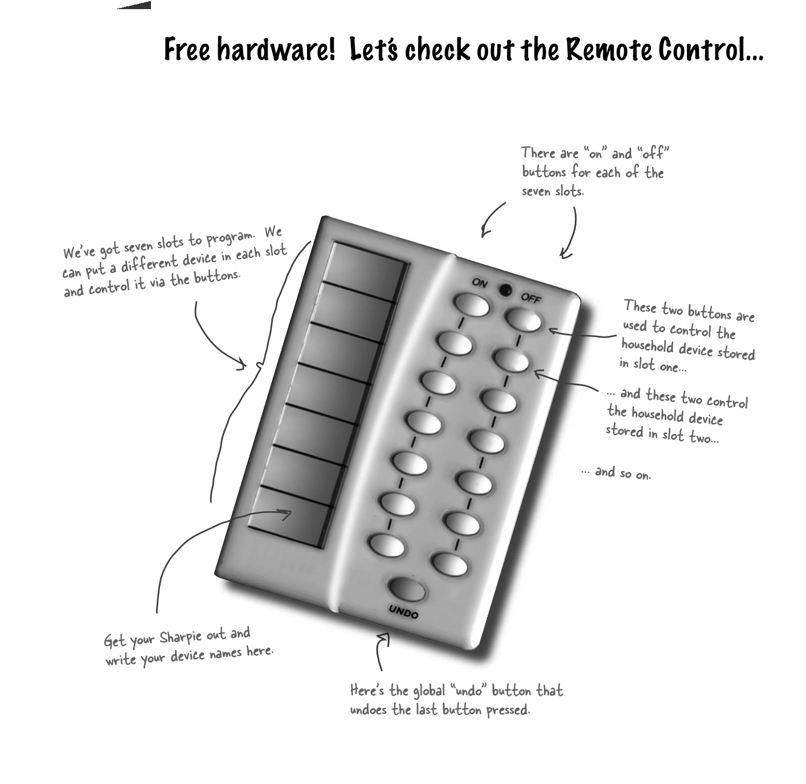

Slide 3
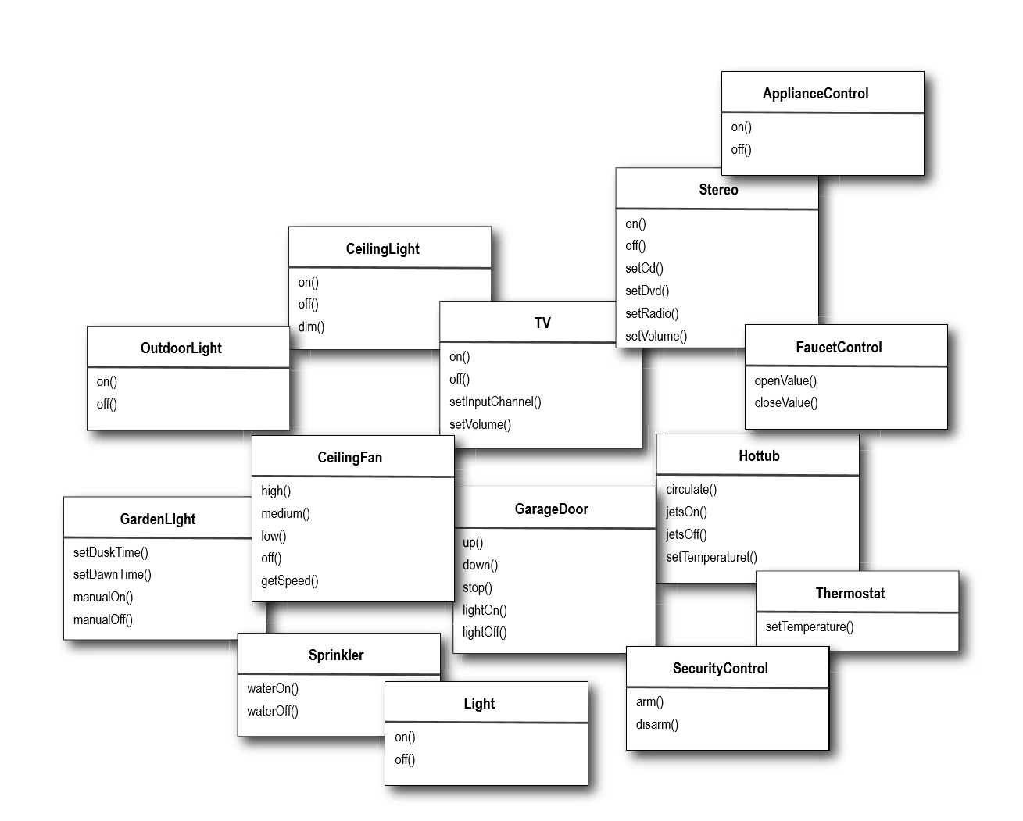
Taking a look at the vendor classes

Slide 4
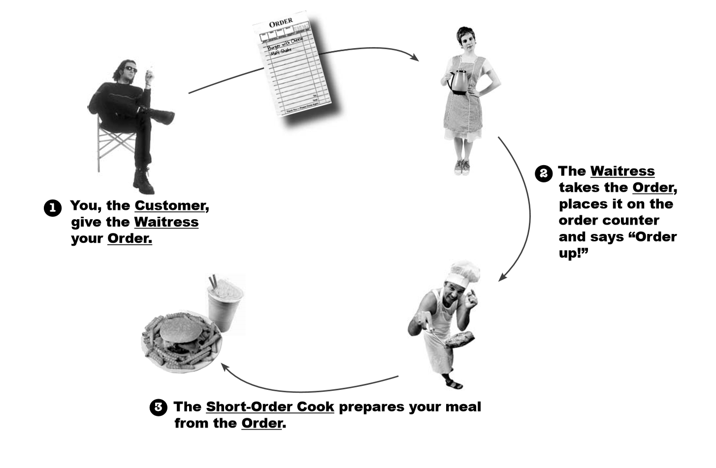
An Example of Command Flow

Slide 5
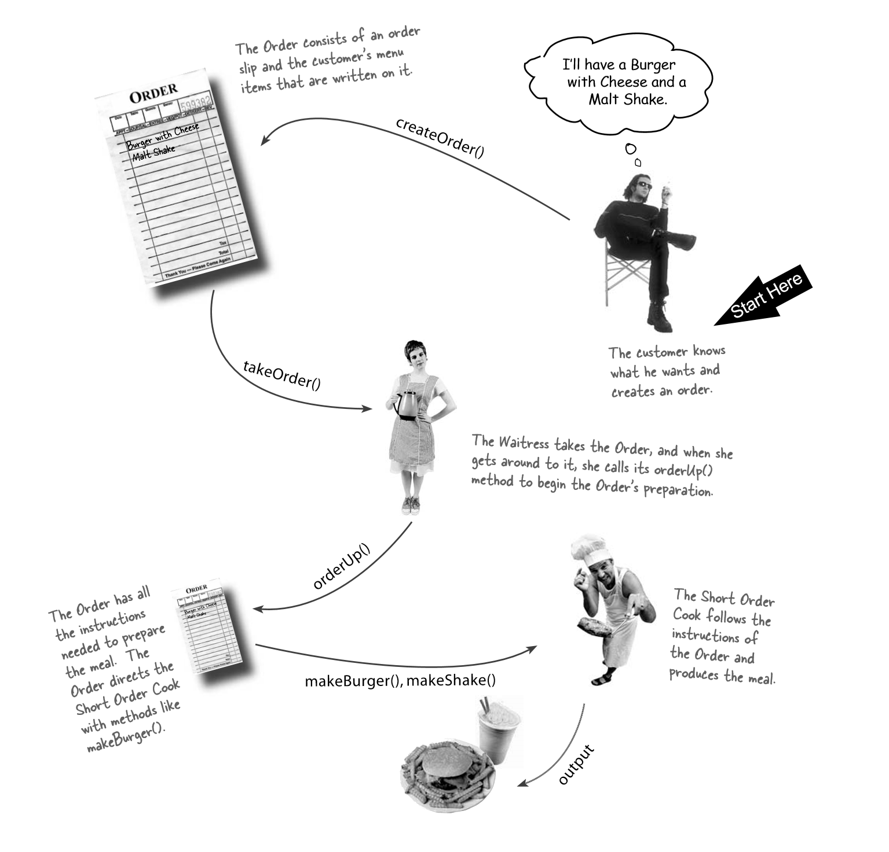
Let’s study the interaction in a little more detail...

Slide 6
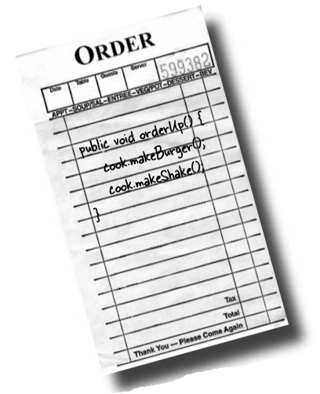
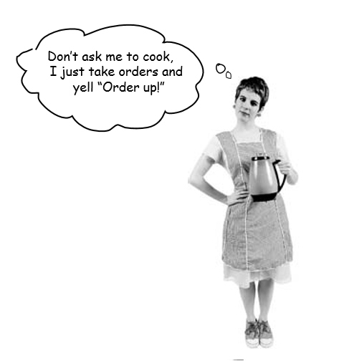
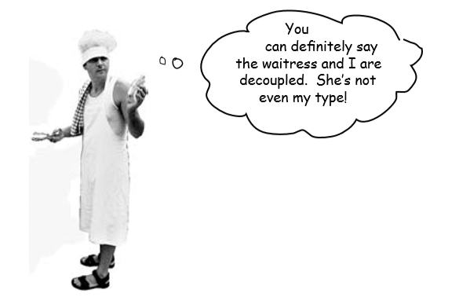
Some more details
Command
Invoker
Executioner(Receiver)
1. An Order Slip encapsulates a request to prepare a meal.
Think of the Order Slip as an object, an object that acts as a request to prepare a meal.
3. The Short Order Cook has the knowledge required to prepare the meal.
2. The Waitress’s job is to take Order Slips and invoke the orderUp() method on them.

Slide 7
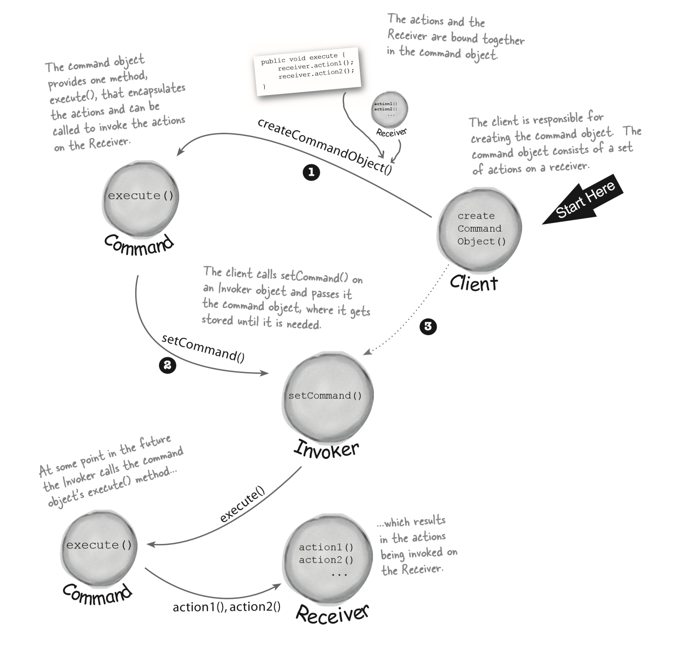

Slide 8
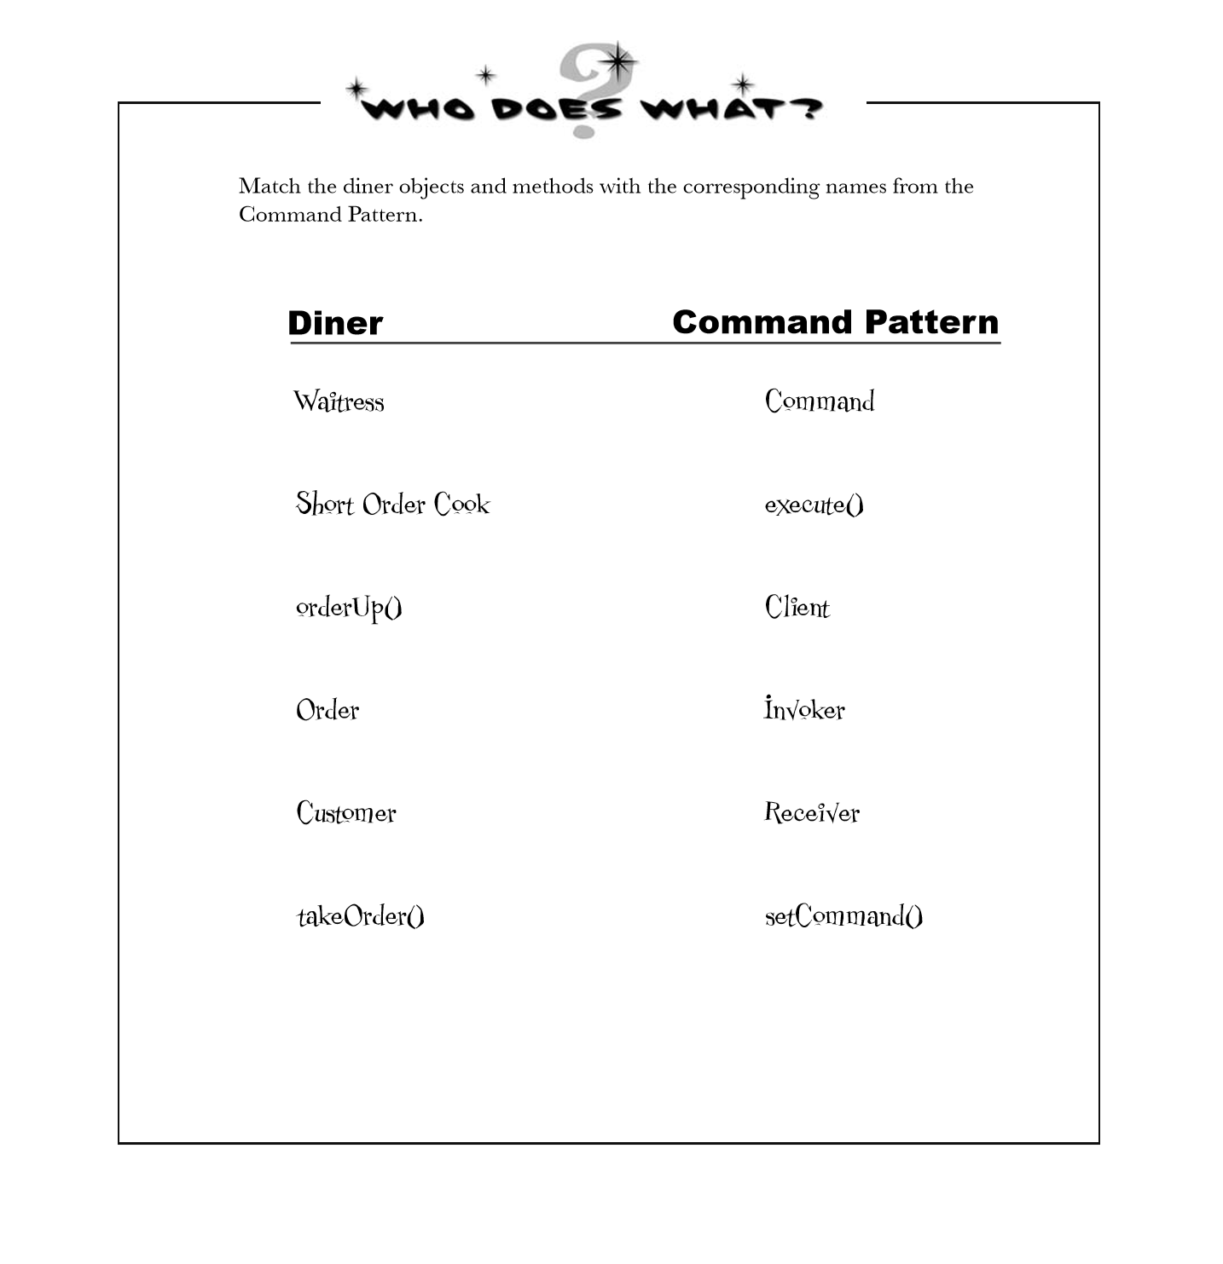

Slide 9
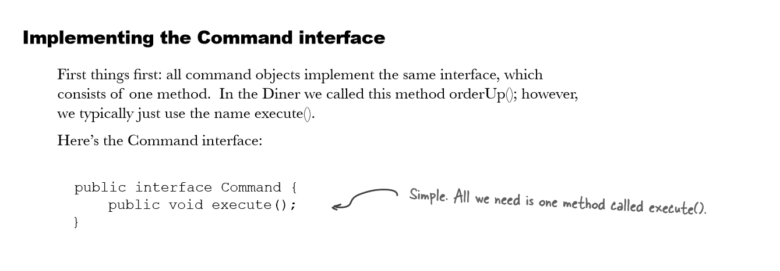
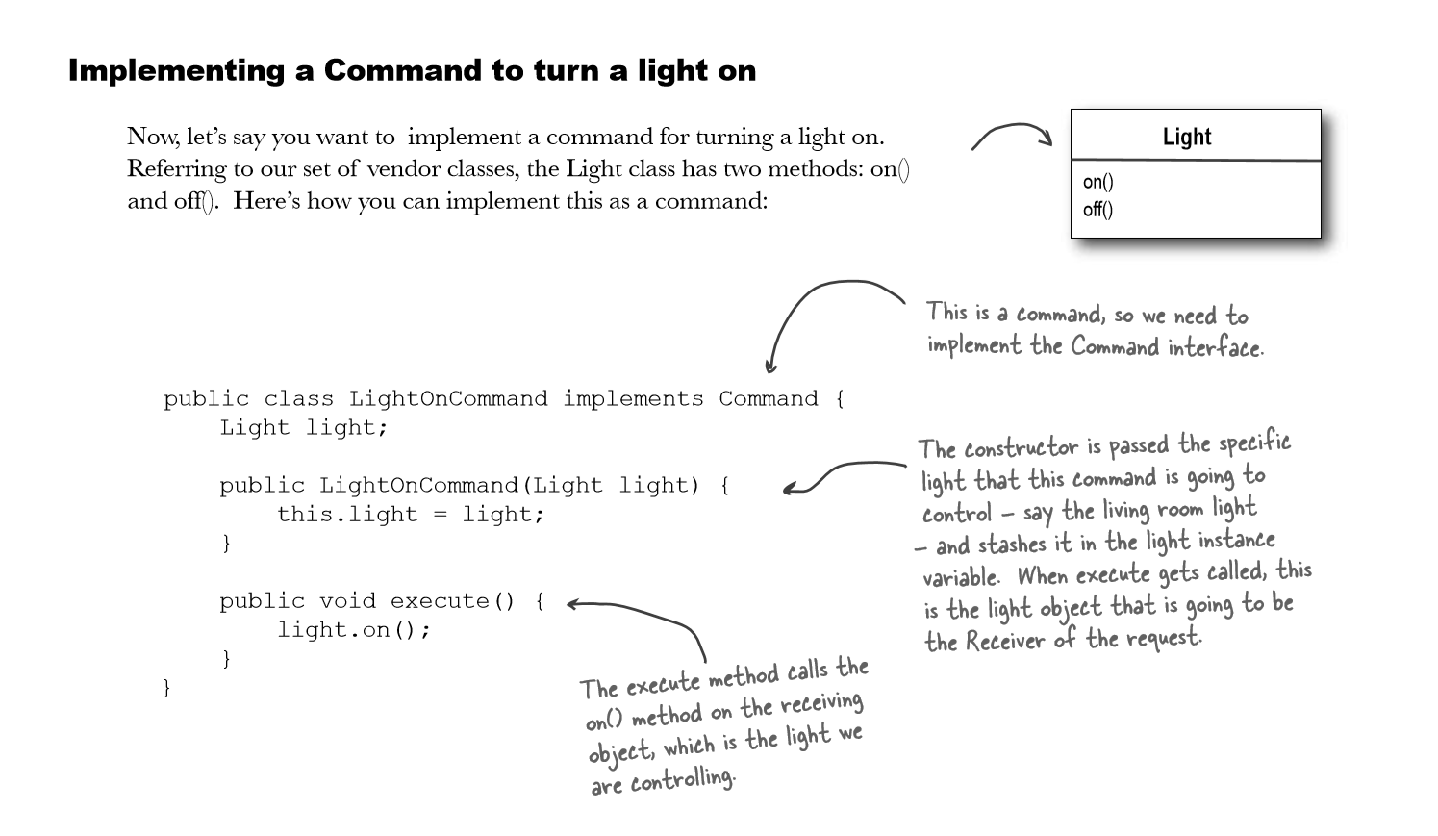
Our first command object

Slide 10
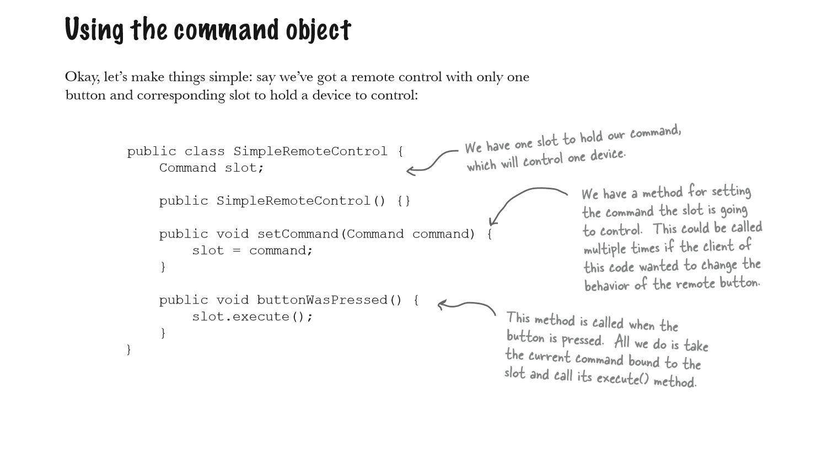

Slide 11
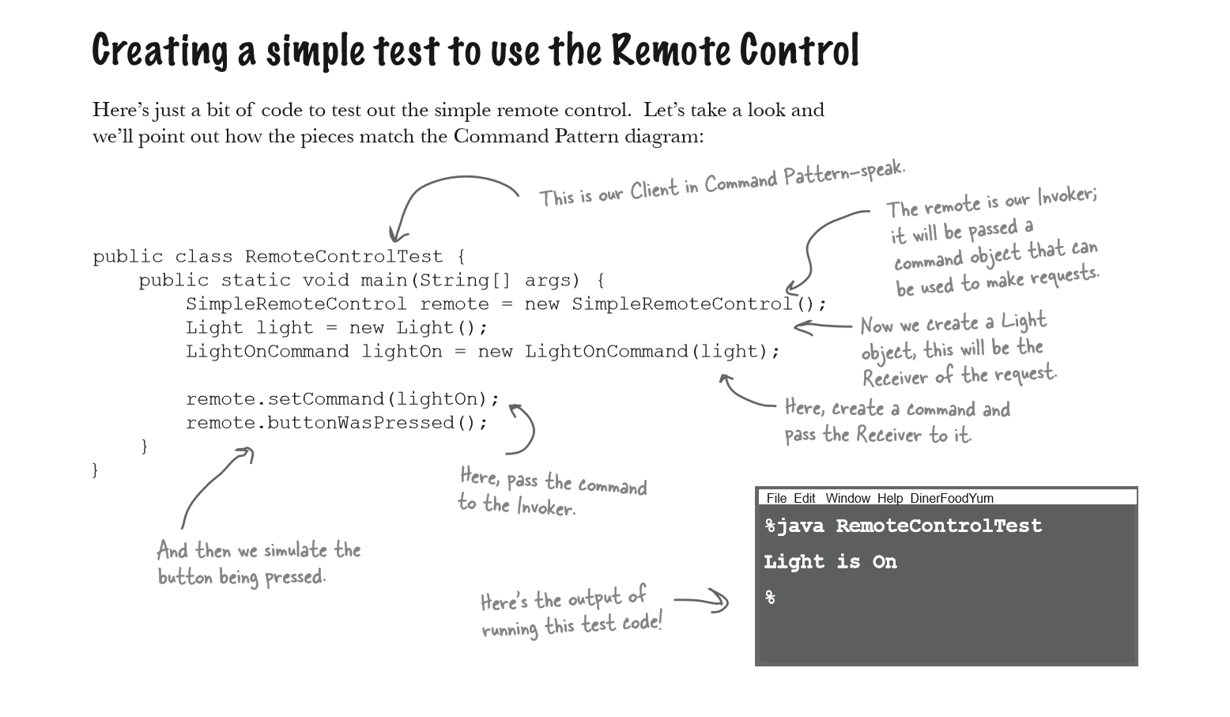
2
1
4
3
6
7
5
8

Slide 12
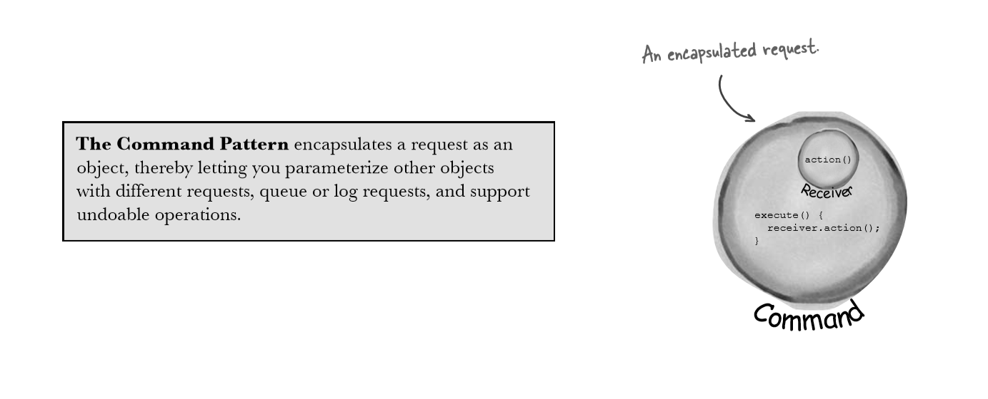
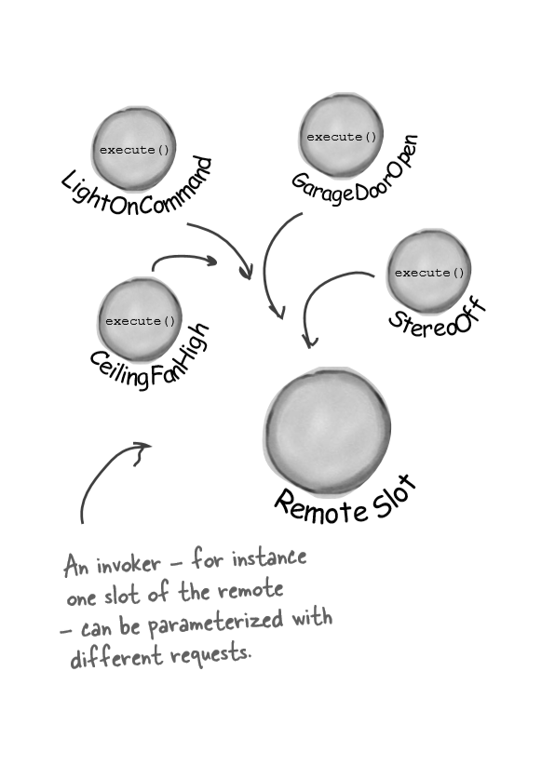
Command Design Pattern
Receiver + action
Command
Feature of the invoker

Slide 13
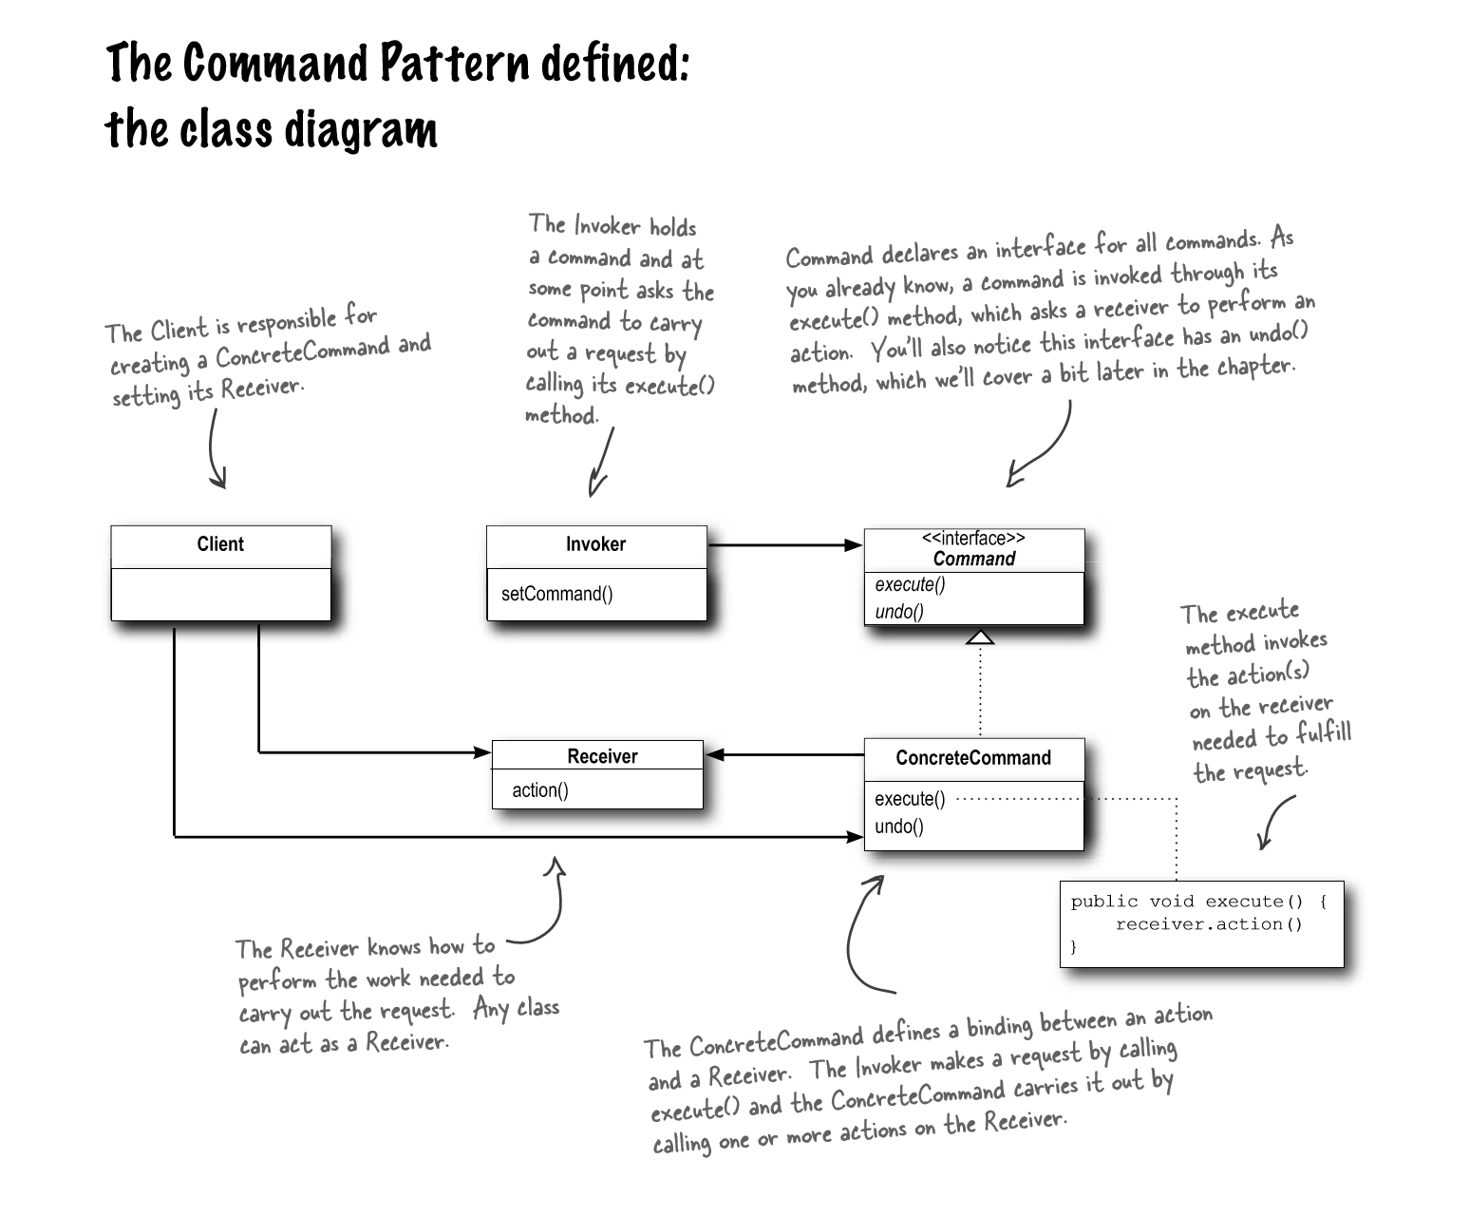
Simplified:
Client creates a command object, consisting of a (receiver + action). This command is a request
Client stores the command into an invoker through setCommand function
Invoker invokes the execute method of the command
Command finally asks the receiver to execute the action

Slide 14
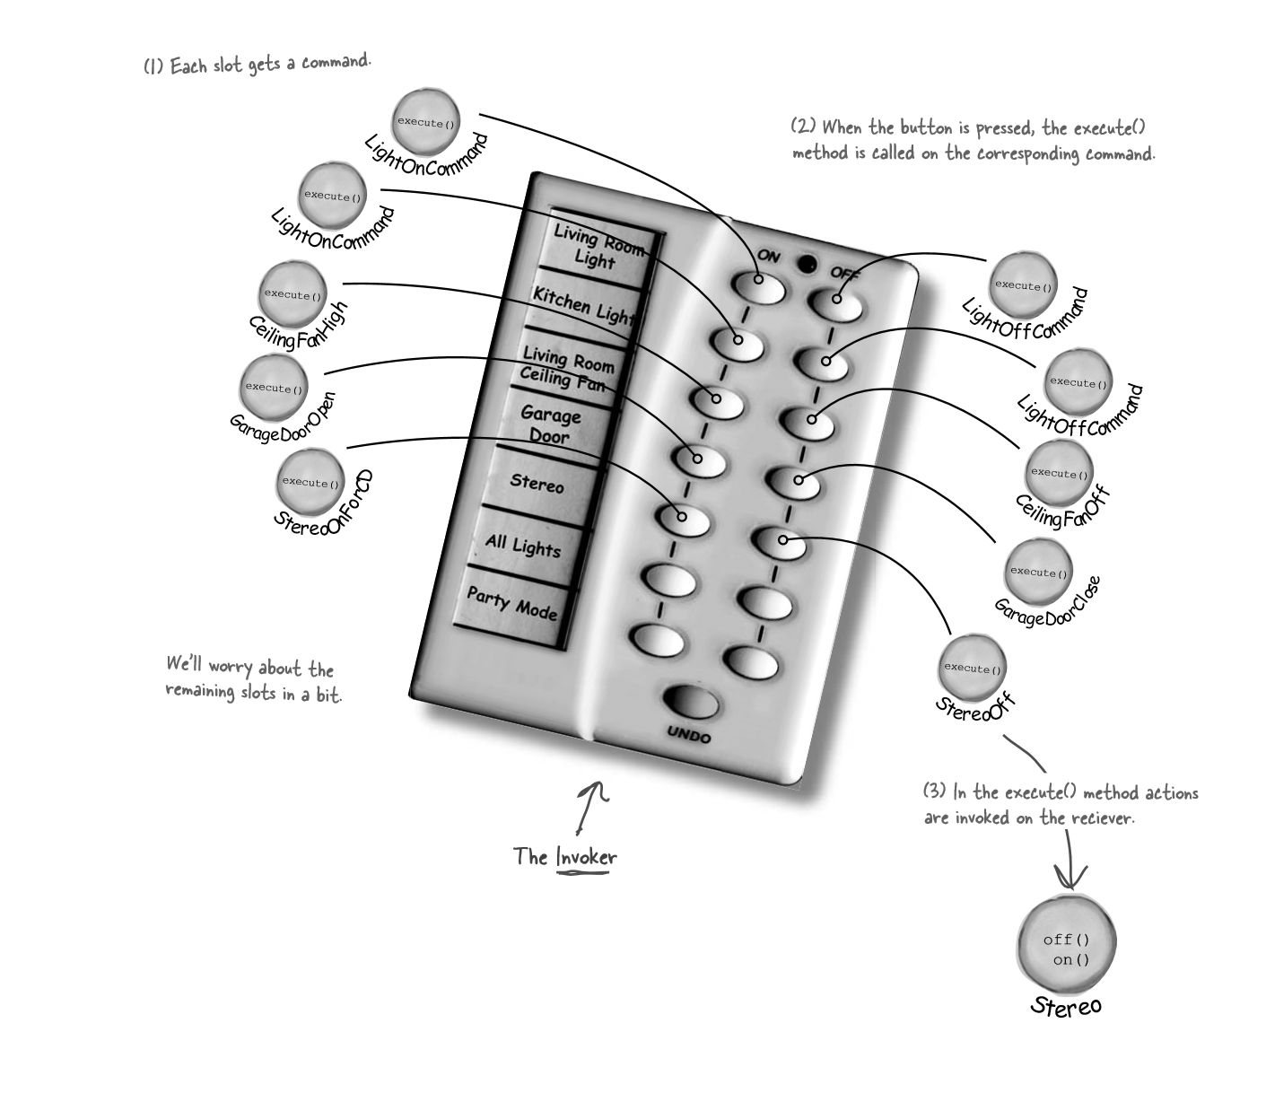
Assigning Commands to slots

Slide 15
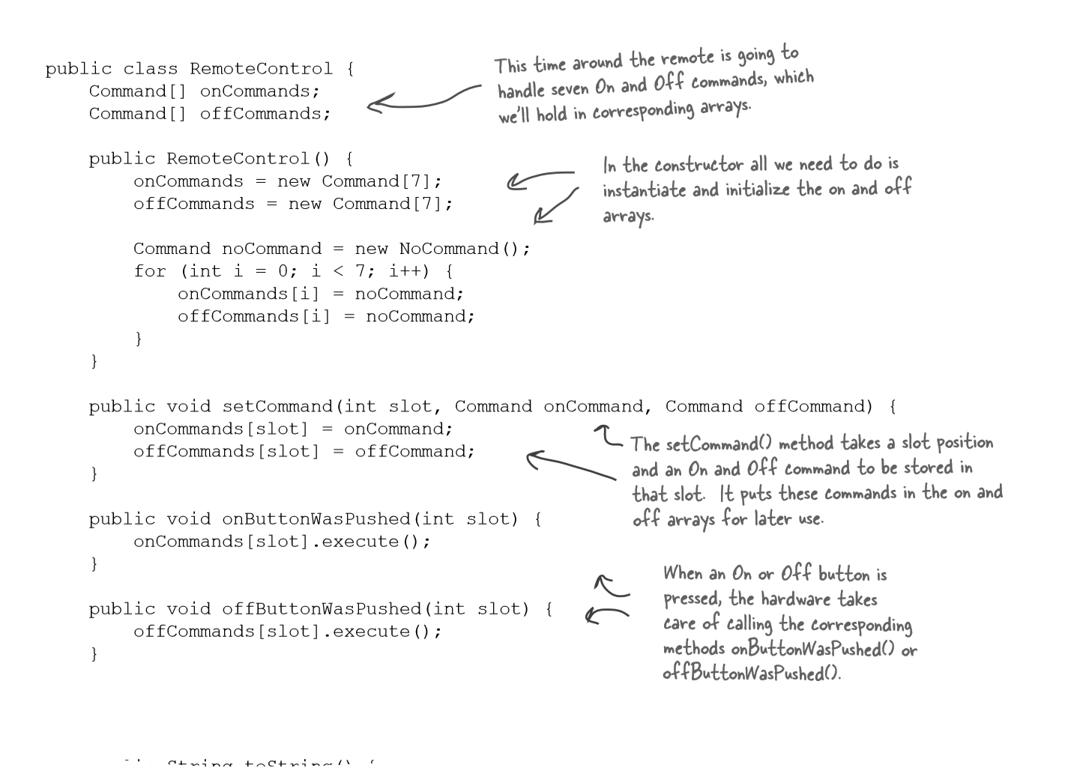
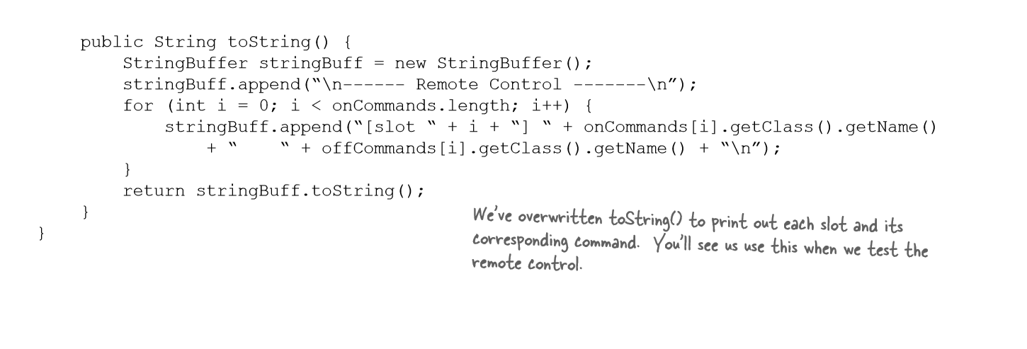
Implementing the RemoteControl class

Slide 16
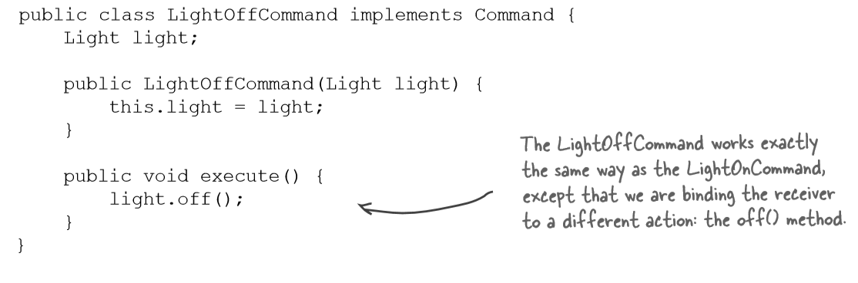
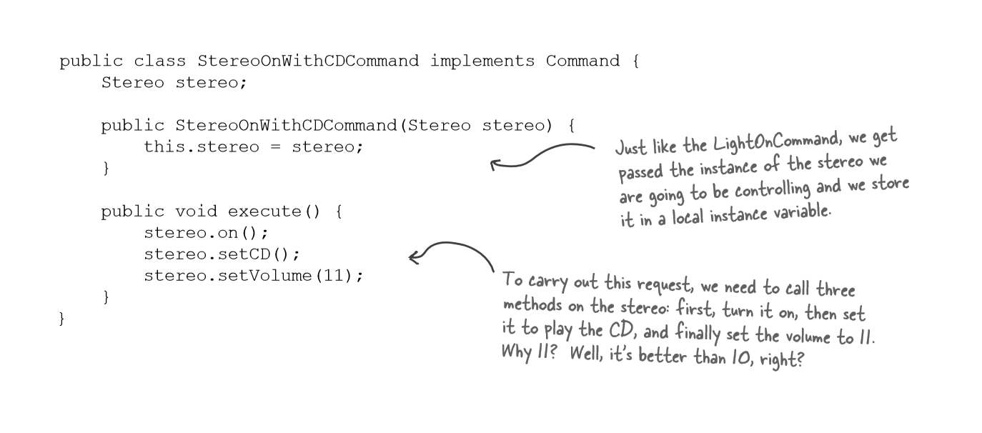
Implementing the commands
Same receiver with different actions
An execute function with multiple commands of the receiver to execute the action

Slide 17
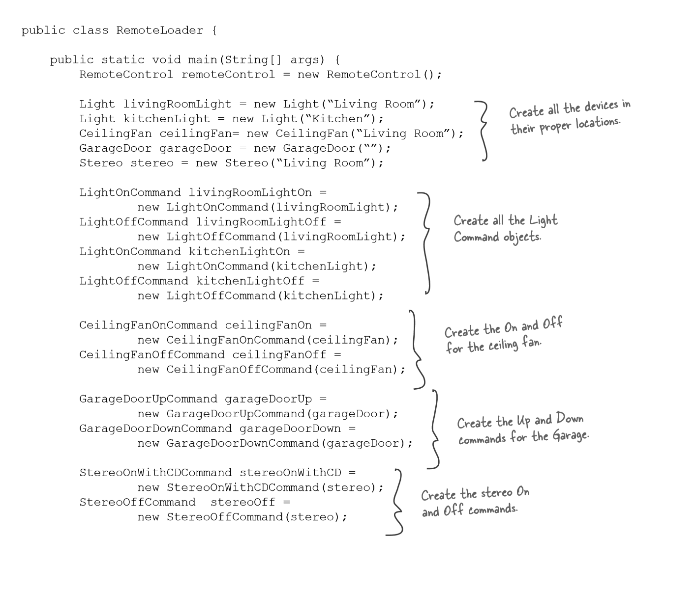
Main Code-I
Receivers
Commands binding receivers with their actions in execute()

Slide 18
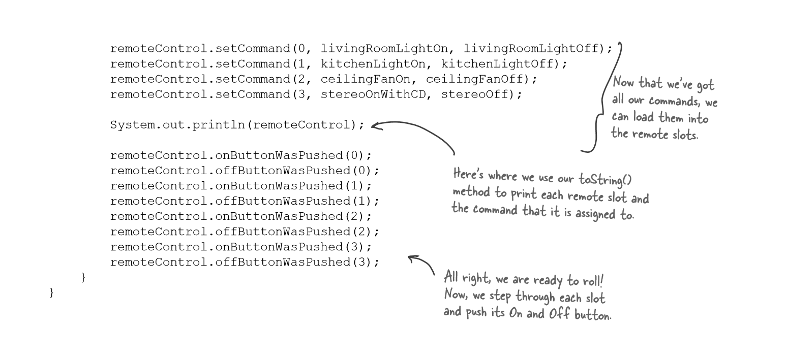
Main Code-II
Setting Commands in invokers
Invokers invoking the commands

Slide 19
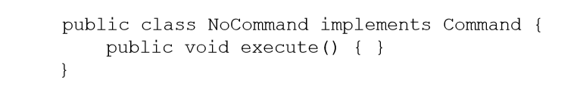
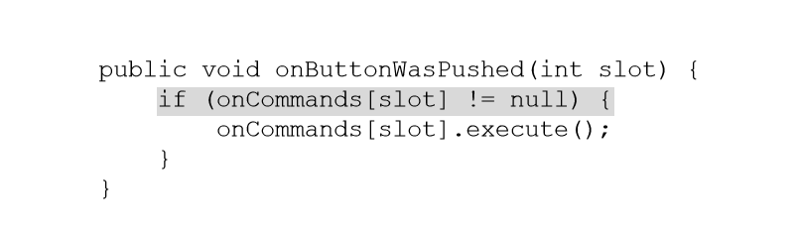
Null Design Pattern
Implementation
As we already have an object, we directly call it without hesitation
But, if kept null values, first we had to check it

Slide 20
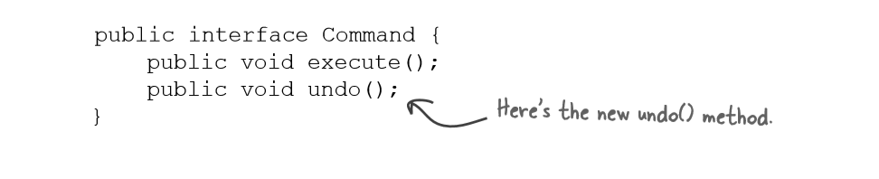
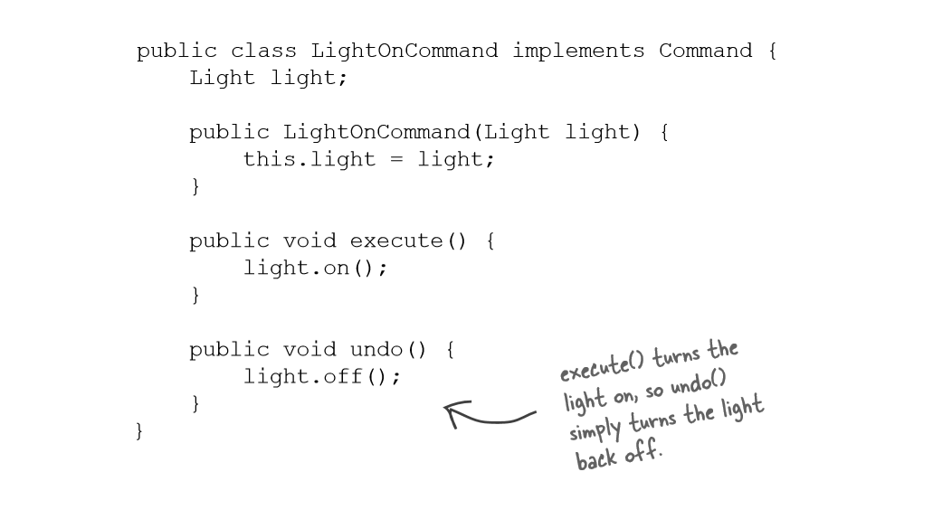
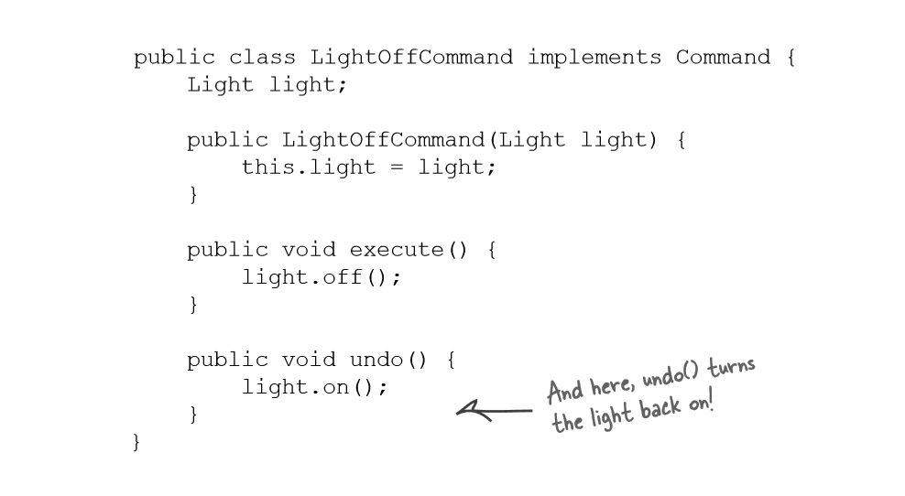
Implementing undo() method

Slide 21
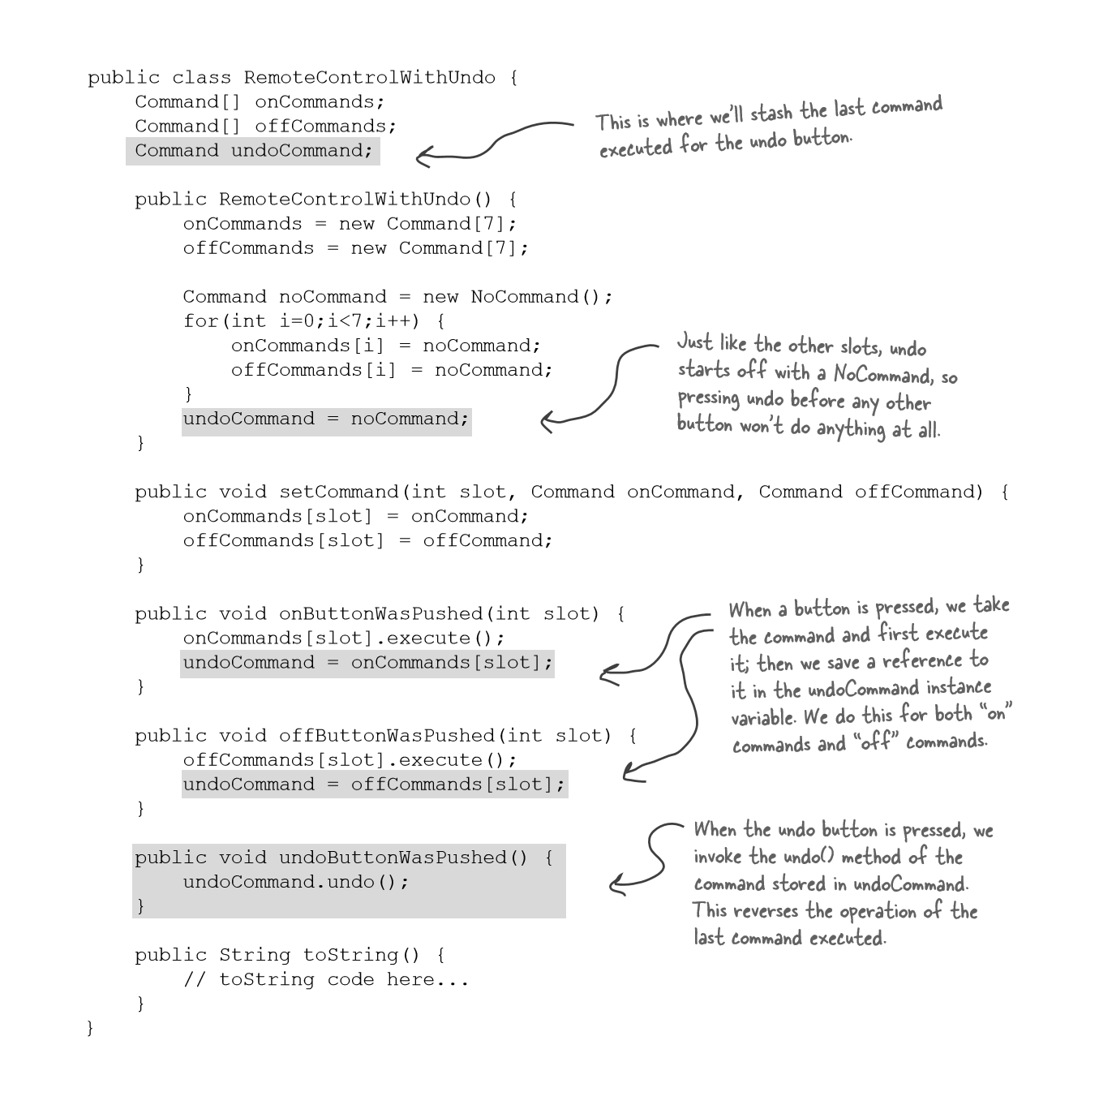
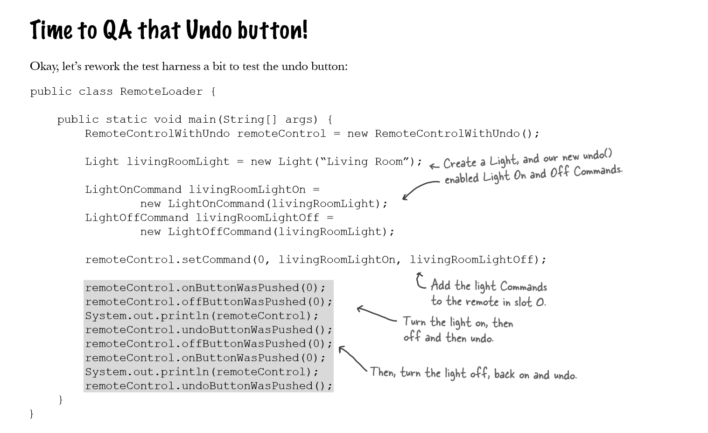
The modified code for undo()

Slide 22
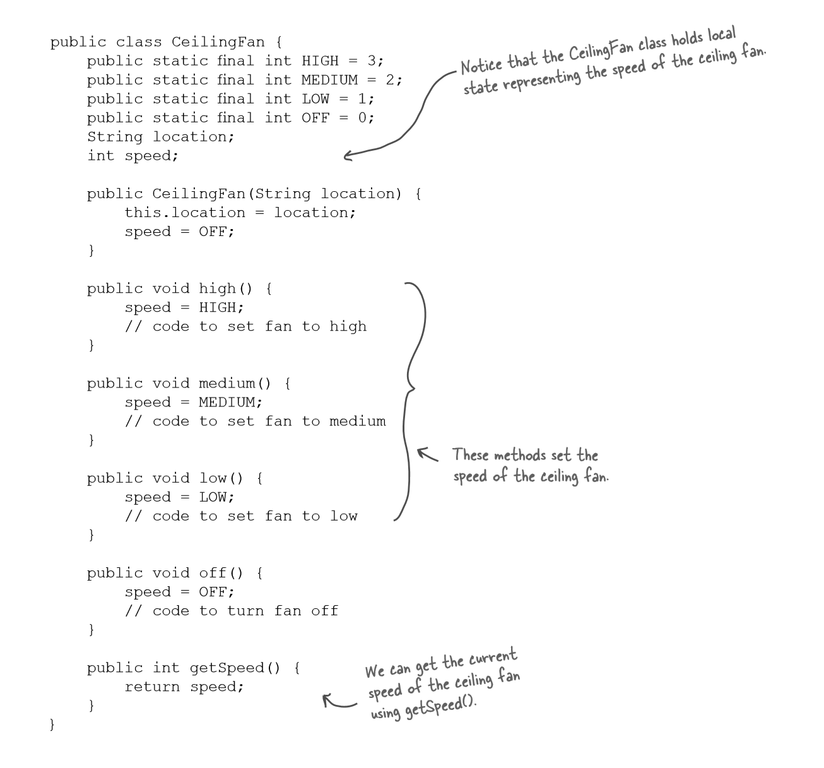
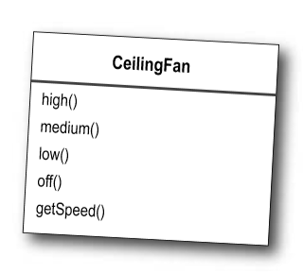
Using state to implement Undo

Slide 23
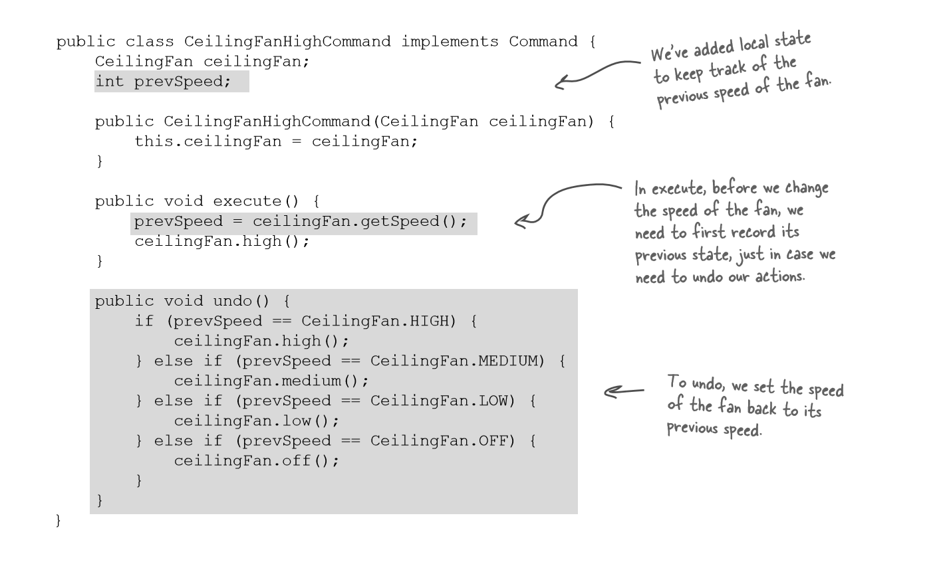
Adding Undo to the ceiling fan commands

Slide 24
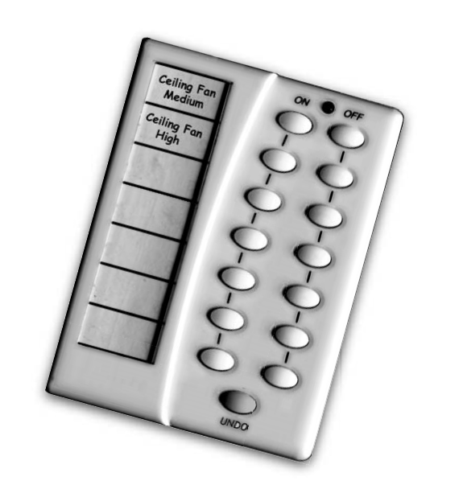
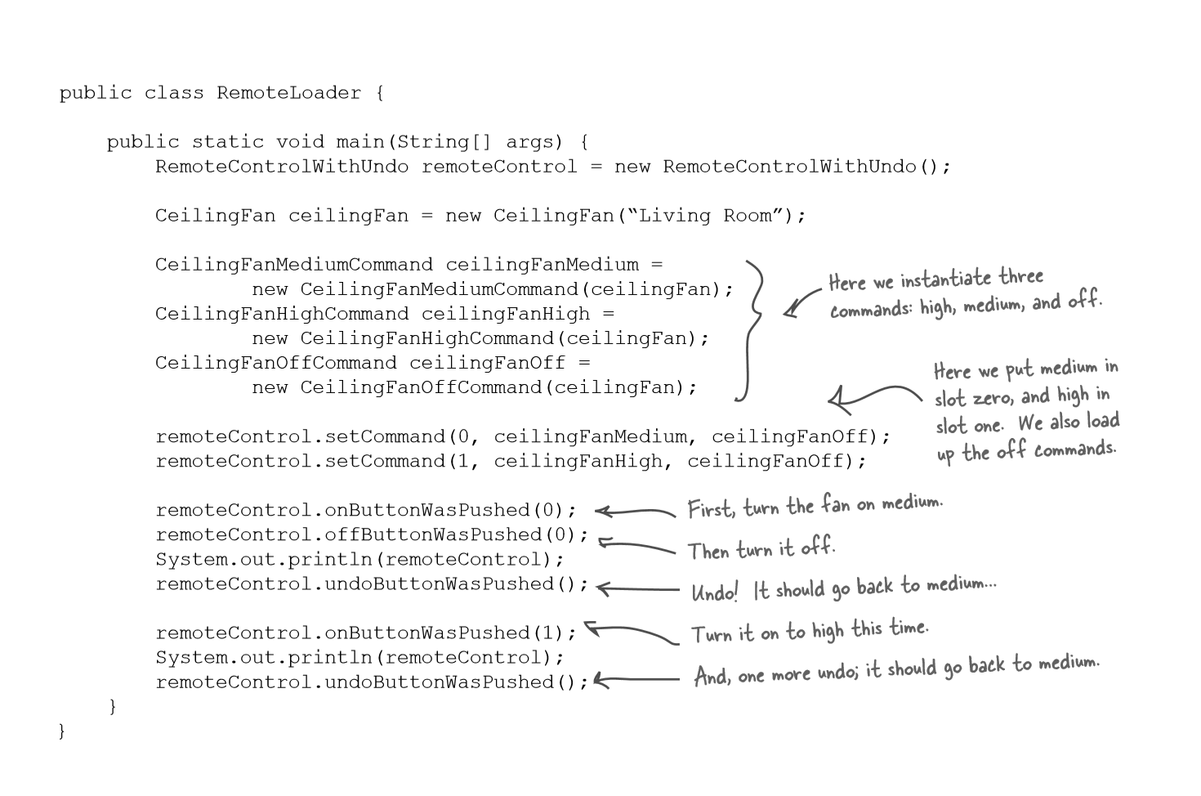

Slide 25
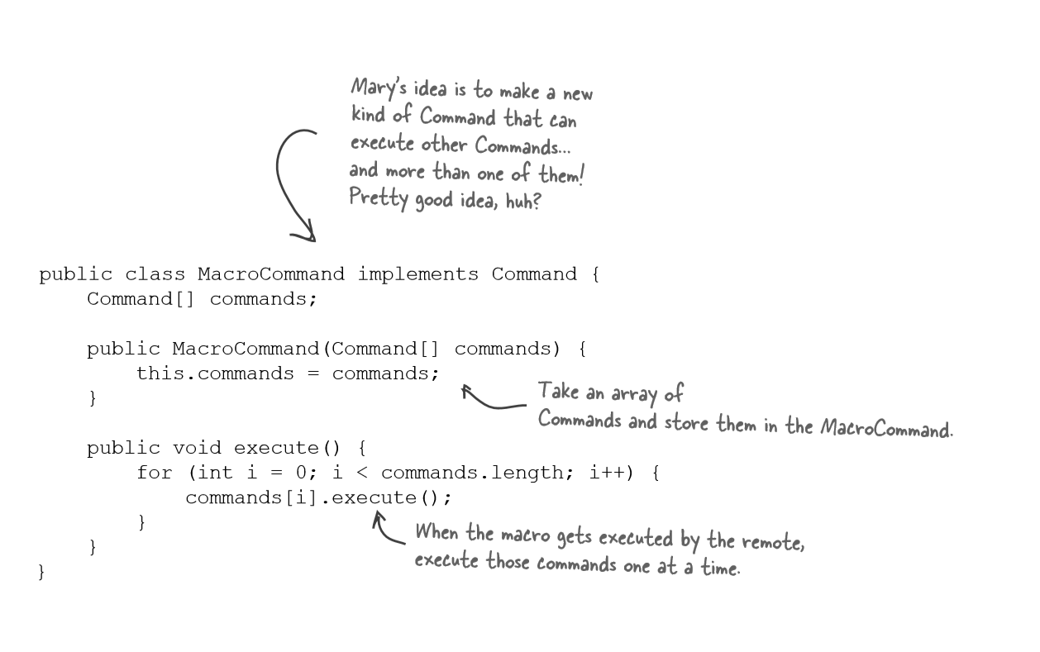
Every remote needs a Party Mode!
A Command that executes multiple commands.

Slide 26
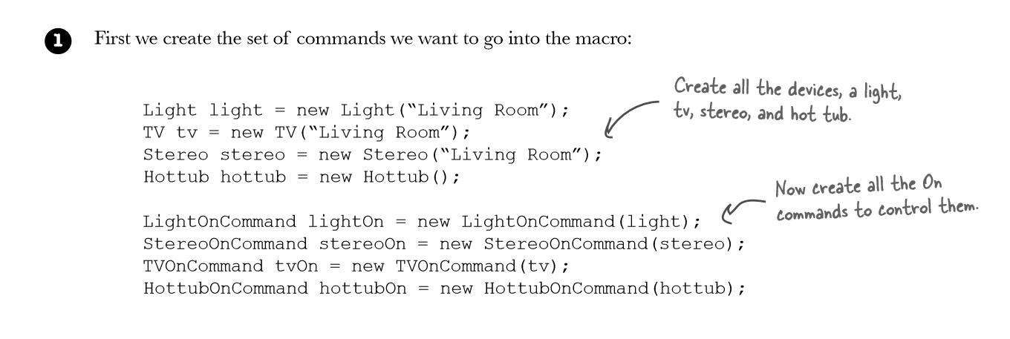
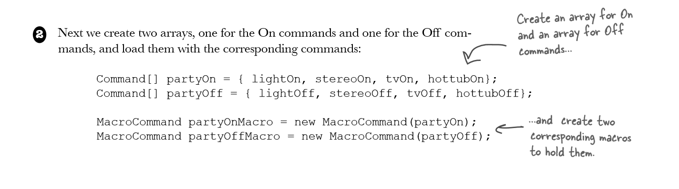
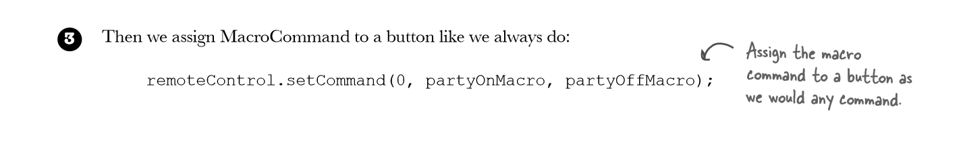

Slide 27
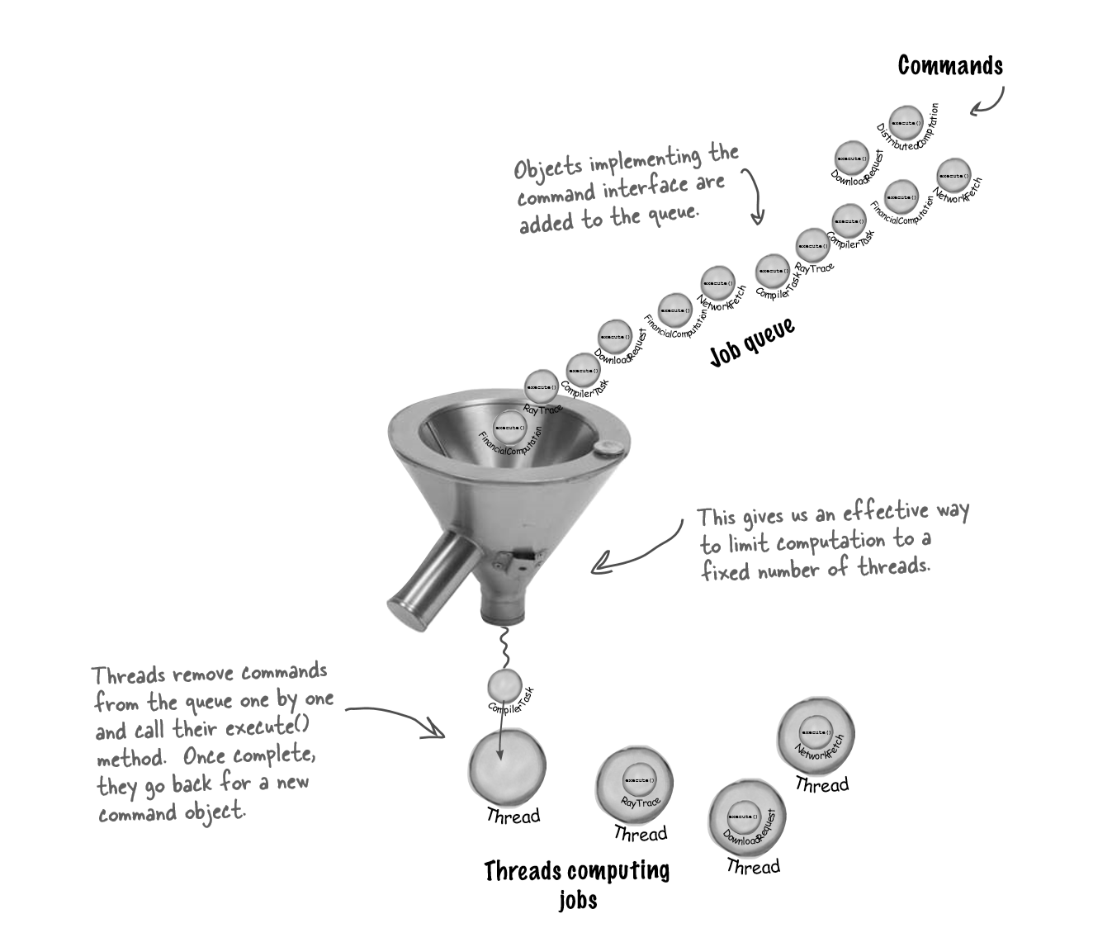
More uses of the Command Pattern: queuing requests
Scheduler
Invokers invoking the commands execute()

Slide 28
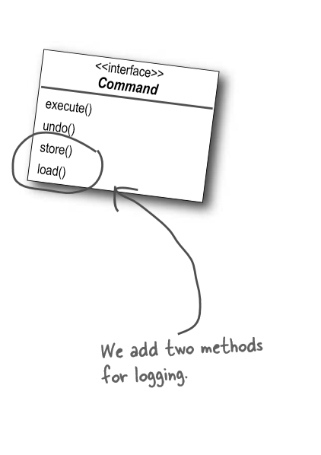
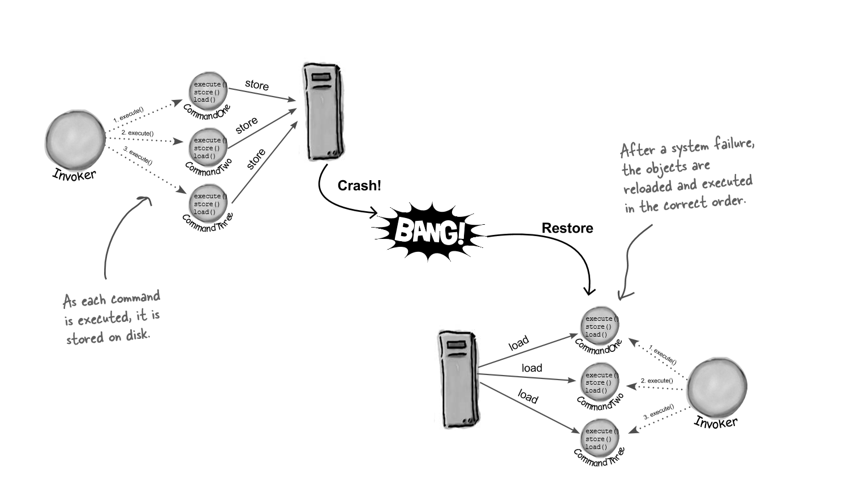
More uses of the Command Pattern: logging requests

Slide 29
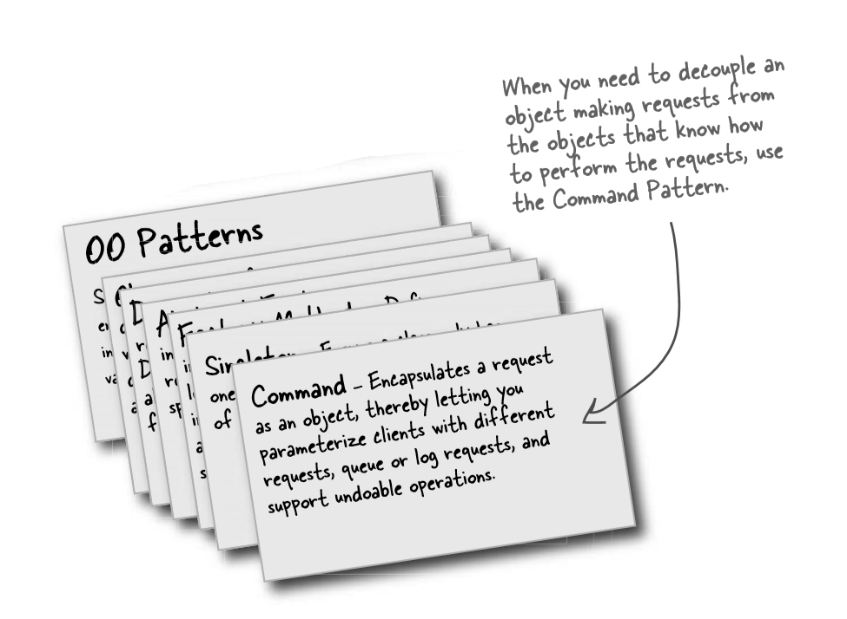
Summary

